Slide 1


The material in this presentation belongs to St. Francis Institute of Technology and is solely for educational purposes. Distribution and modifications of the content is prohibited.
Database Management System (DBMS)
CSC403
Subject Incharge
Dr. Kavita Sonawane
Professor & HOD
email: kavitasonawane@sfit.ac.in
St. Francis Institute of Technology
Department of Computer Engineering
Database Management System
Kavita Sonawane
1

Slide 2
Module 2
The material in this presentation belongs to St. Francis Institute of Technology and is solely for educational purposes. Distribution and modifications of the content is prohibited.
St. Francis Institute of Technology
Department of Computer Engineering
Database Management System
2

Slide 3
Module 2
The material in this presentation belongs to St. Francis Institute of Technology and is solely for educational purposes. Distribution and modifications of the content is prohibited.
Entity–Relationship Data Model
St. Francis Institute of Technology
Department of Computer Engineering
Database Management System
3

Slide 4
ER model stands for an Entity-Relationship model.
It is a high-level data model.
This model is used to define the data elements and relationship for a specified system.
It develops a conceptual design for the database. It also develops a very simple and easy to design view of data.

Slide 5
The material in this presentation belongs to St. Francis Institute of Technology and is solely for educational purposes. Distribution and modifications of the content is prohibited.
ER diagram basically having three components:
Entities − It is a real-world thing which can be a person, place.
For Example: Department, Admin, Courses, Teachers, Students, Building, etc are some of the entities of a School Management System.
Attributes − An entity which contains a real-world property called an attribute.
For Example: The entity employee has the property like employee id, salary, age, etc.
Relationship − Relationship tells how two entities are related.
For Example: Employee works for a department.
St. Francis Institute of Technology
Department of Information Technology
5

Slide 6
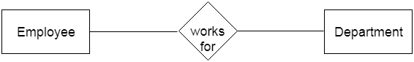
1. Entity
An entity may be any object, class, person or place. In the ER diagram, an entity can be represented as rectangles.
Consider an organization as an example- manager, product, employee, department etc. can be taken as an entity.
St. Francis Institute of Technology
Department of Computer Engineering
Database Management System
6

Slide 7
Entity set
An entity set is a collection of same type of entities i.e. they share same properties or attributes.
Consider example of a student. A student has a unique roll no, name, date of birth etc. So an entity set will be set of all those people in a college or school who are students.
Roll No. | Name | Date of Birth
101 | Keith | 12.12.1992
102 | Adrian | 14.06.1993
103 | Anne | 04.09.1993
104 | Mathew | 07.08.1991

Slide 8
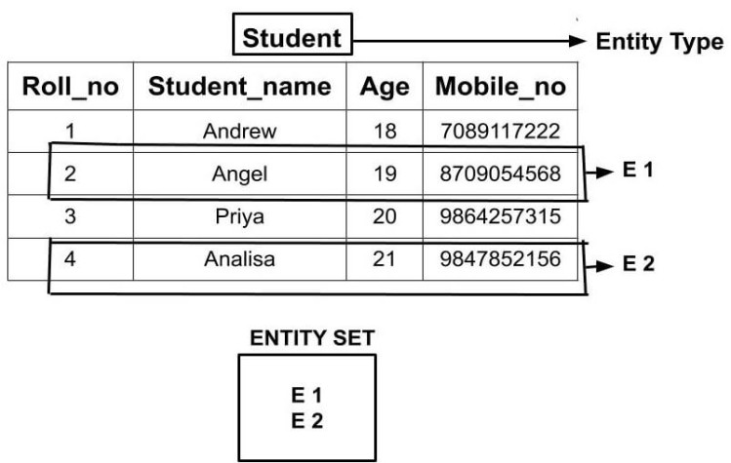

Slide 9
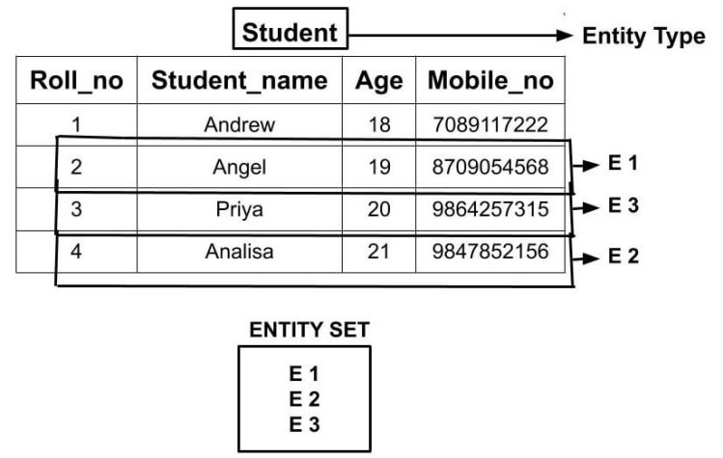

Slide 10
Types of Entity:
1] strong entity
2] Weak entity

Slide 11
Strong entity
Strong Entity is independent of any other entity in the schema
Example – A student entity can exist without needing any other entity in the schema or a course entity can exist without needing any other entity in the schema
A Strong entity is nothing but an entity set having a primary key attribute or a table that consists of a primary key column

Slide 12
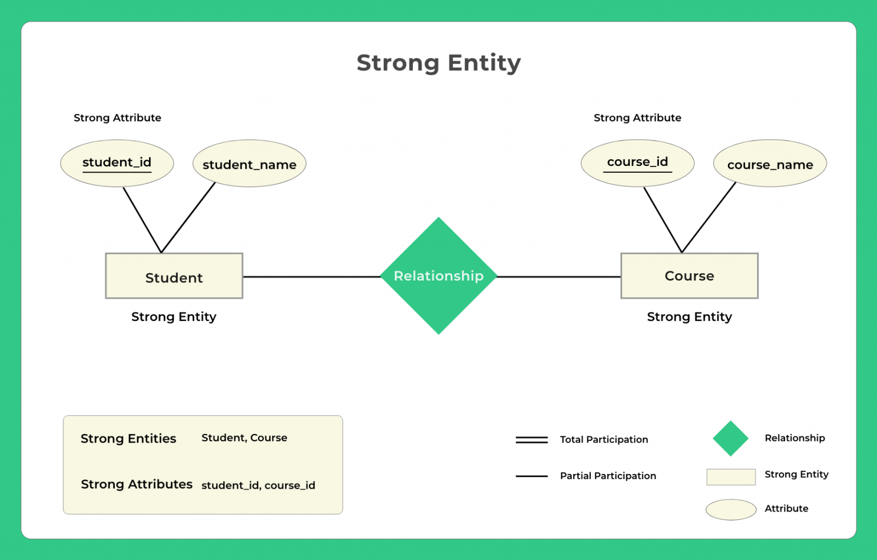

Slide 13
Representation
The strong entity is represented by a single rectangle.
The relationship between two strong entities is represented by a single diamond.

Slide 14
Consider above the ER diagram which consists of two entities student and course
Student entity is a strong entity because it consists of a primary key called student id which is enough for accessing each record uniquely
In the same way, the course entity contains of course ID attribute which is capable of uniquely accessing each row.

Slide 15
Weak entity
A weak entity is an entity set that does not have sufficient attributes for Unique Identification of its records.
An entity that depends on another entity called a weak entity.
Example 1 – A loan entity can not be created for a customer if the customer doesn’t exist

Slide 16
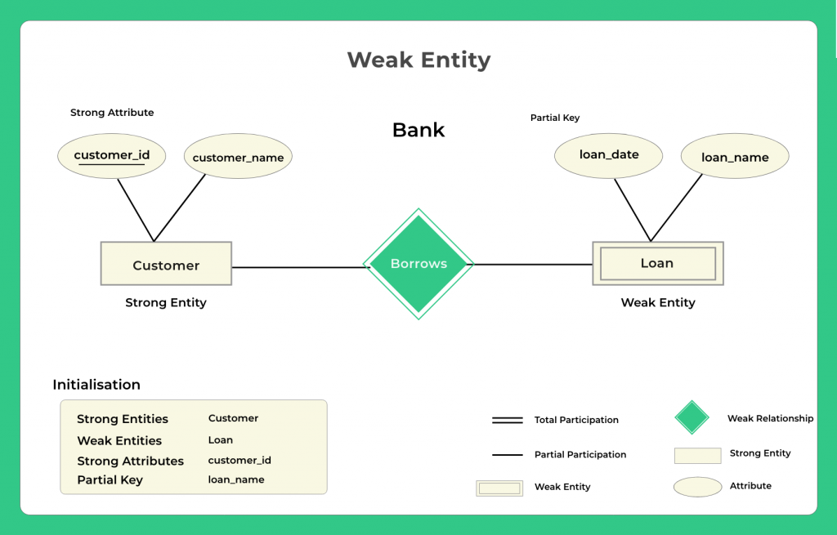

Slide 17
a weak entity is nothing but an entity that does not have a primary key attribute
It contains a partial key called a discriminator which helps in identifying a group of entities from the entity set
A discriminator is represented by underlining with a dashed line

Slide 18
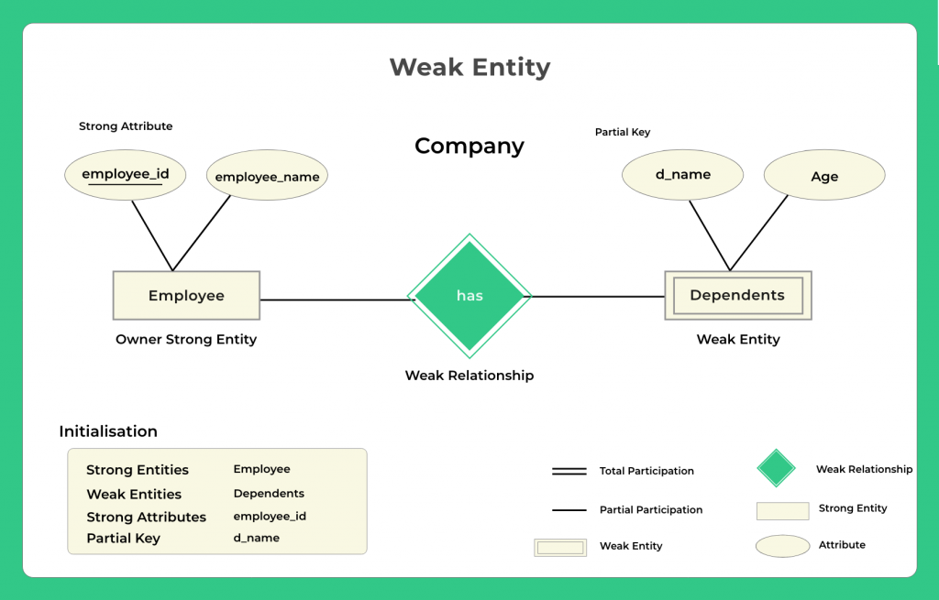
Example 2 – A dependents list entity can not be created if the employee doesn’t exist

Slide 19
In the ER diagram, we have two entities Employee and Dependents.
Employee is a strong entity because it has a primary key attribute called Employee number (Employee_No) which is capable of uniquely identifying all the employee.
Unlike Employee, Dependents is weak entity because it does not have any primary key .
D_Name along with the Employee_No can uniquly identfy the records of Depends. So here the D_Name (Depends Name) is partial key.

Slide 20
Representation
A double rectangle is used for representing a weak entity set
The double diamond symbol is used for representing the relationship between a strong entity and a weak entity which is known as identifying relationship

Slide 21
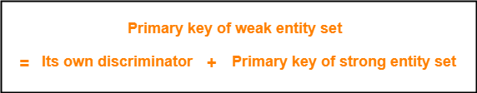
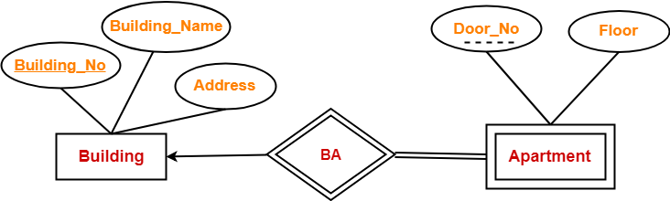

Slide 22
In this ER diagram,
One strong entity set “Building” and one weak entity set “Apartment” are related to each other.
Strong entity set “Building” has building number as its primary key.
Door number is the discriminator of the weak entity set “Apartment”.
This is because door number alone can not identify an apartment uniquely as there may be several other buildings having the same door number.
Double line between Apartment and relationship set signifies total participation.
It suggests that each apartment must be present in at least one building.
Single line between Building and relationship set signifies partial participation.
It suggests that there might exist some buildings which has no apartment.

Slide 23
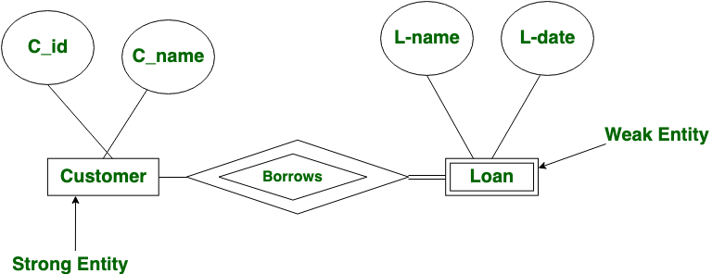
The material in this presentation belongs to St. Francis Institute of Technology and is solely for educational purposes. Distribution and modifications of the content is prohibited.
The relation between one strong and one weak entity is represented by a double diamond. This relationship is also known as identifying relationship.
St. Francis Institute of Technology
Department of Cmputer Engineering
Database Management System
23

Slide 24
A weak entity is one that can only exist when owned by another one.
Example-1: The existence of rooms is entirely dependent on the existence of a hotel. So room can be seen as the weak entity of the hotel.
Example-2: The bank account of a particular bank has no existence if the bank doesn’t exist anymore.

Slide 25
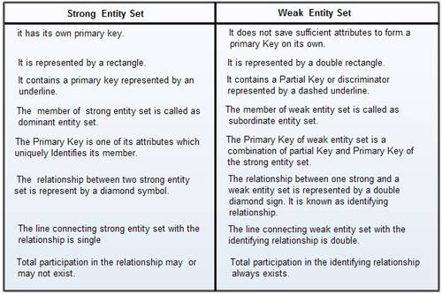

Slide 26
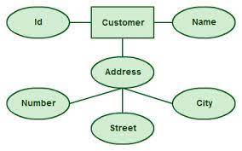
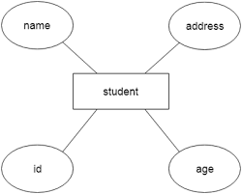
2. Attribute
The attribute is used to describe the property of an entity. Ellipses is used to represent an attribute.
For example, id, age, contact number, name, etc. can be attributes of a student.

Slide 27
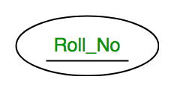
The material in this presentation belongs to St. Francis Institute of Technology and is solely for educational purposes. Distribution and modifications of the content is prohibited.
A. Key Attribute
The attribute which uniquely identifies each entity in the entity set is called key attribute.
For example, Roll_No or student ID will be unique for each student.
In ER diagram, key attribute is represented by an oval with underlying lines.
St. Francis Institute of Technology
Department of Computer Engineering
Database Management System
27

Slide 28
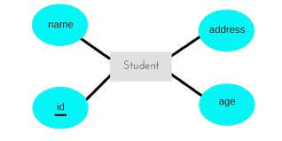
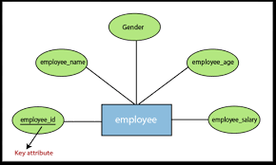

Slide 29
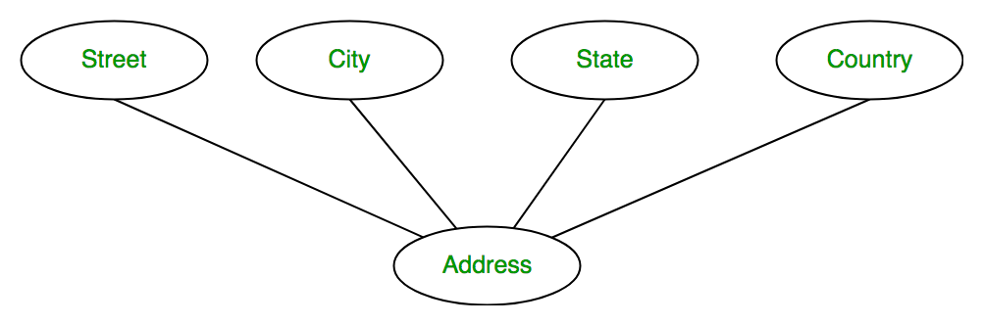
The material in this presentation belongs to St. Francis Institute of Technology and is solely for educational purposes. Distribution and modifications of the content is prohibited.
b. Composite Attribute
An attribute that composed of many other attributes is known as a composite attribute. The composite attribute is represented by an ellipse, and those ellipses are connected with an ellipse.
For example, Address attribute of student Entity type consists of Street, City, State, and Country.
St. Francis Institute of Technology
Department of Computer Engineering
Database Management System
29

Slide 30
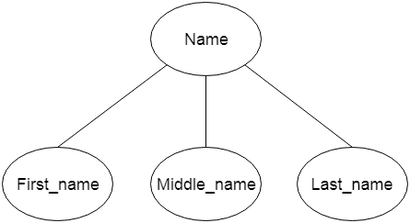

Slide 31
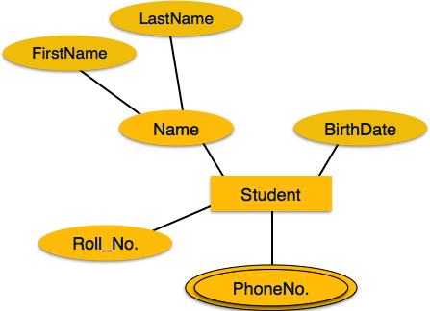
The material in this presentation belongs to St. Francis Institute of Technology and is solely for educational purposes. Distribution and modifications of the content is prohibited.
c. Multivalued Attribute
An attribute can have more than one value. These attributes are known as a multivalued attribute. The double oval is used to represent multivalued attribute.
For example, a student can have more than one phone number.
St. Francis Institute of Technology
Department of Computer Engineering
Database Management System
Prachiti Pimple
31

Slide 32
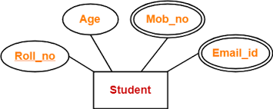
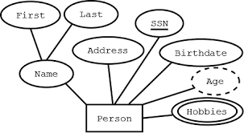

Slide 33
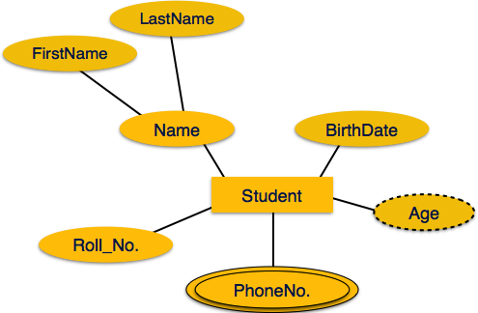
The material in this presentation belongs to St. Francis Institute of Technology and is solely for educational purposes. Distribution and modifications of the content is prohibited.
d. Derived Attribute
An attribute that can be derived from other attribute is known as a derived attribute. It can be represented by a dashed ellipse.
For example, A person's age changes over time and can be derived from another attribute like Date of birth.
St. Francis Institute of Technology
Department of Computer Engineering
Database Management System
Prachiti Pimple
33

Slide 34
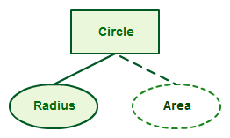
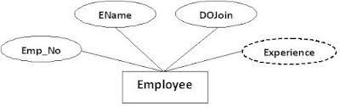

Slide 35
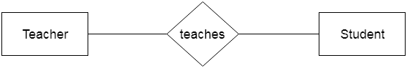
The material in this presentation belongs to St. Francis Institute of Technology and is solely for educational purposes. Distribution and modifications of the content is prohibited.
3. Relationship
A relationship is used to describe the relation between entities.
Diamond or rhombus is used to represent the relationship.
St. Francis Institute of Technology
Department of Computer Engineering
Database Management System
35

Slide 36
Cardinality
Cardinality defines the number of attributes in one entity set, which can be associated with the number of attributes of another set via a relationship set.
it refers to the relationship one table can have with the other table.
Defines the numerical attributes of the relationship between two entities or entity sets.
Different types of cardinal relationships are:
One-to-One Relationships
One-to-Many Relationships
May to One Relationships
Many-to-Many Relationships

Slide 37
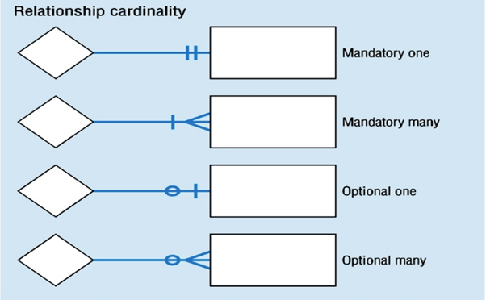

Slide 38
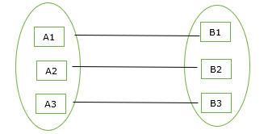
a. One-to-One Relationship
By this cardinality constraint,
An entity in set A can be associated with at most one entity in set B.
An entity in set B can be associated with at most one entity in set A.
One entity of A is associated with one entity of B

Slide 39
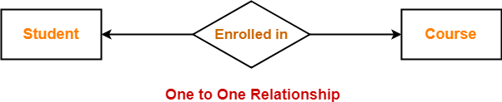
Example-
Consider the following ER diagram-
Here,
One student can enroll in at most one course.
One course can be enrolled by at most one student.

Slide 40
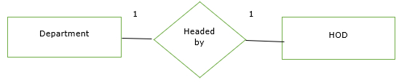
Example
1] Here, one department has one head of the department (HOD).
2] A relationship between person and passport is one to one because a person can have only one passport and a passport can be assigned to only one person.

Slide 41
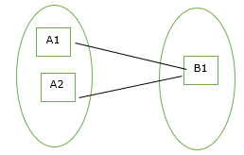
2. Many-to-One Cardinality
By this cardinality constraint,
An entity in set A can be associated with at most one entity in set B.
An entity in set B can be associated with any number (zero or more) of entities in set A.

Slide 42
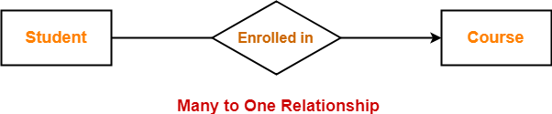
here
Many students can enroll in one course.

Slide 43
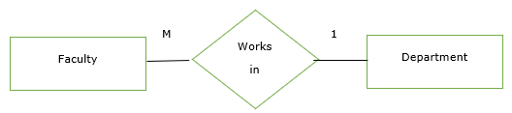
Example
1] Here, many faculties work in one department.
2] Relationship between student and university is many to one because a university can have many students but a student can only study only in single university at a time.

Slide 44
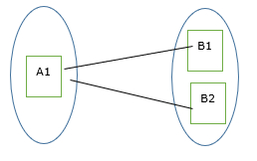
3. One-to-Many Cardinality-
By this cardinality constraint,
An entity in set A can be associated with any number of entities in set B.
An entity in set B can be associated with at most one entity in set A.

Slide 45
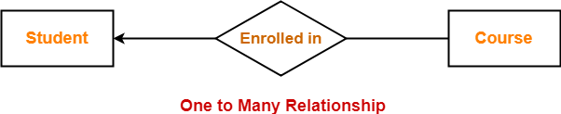
Here,
One student can enroll in any number of courses.

Slide 46
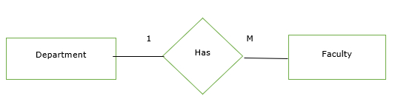
Example
1] Here, one department has many faculties.
2] Relationship between customer and order is one to many because a customer can place many orders

Slide 47
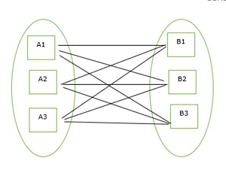
4. Many-to-Many Cardinality
By this cardinality constraint,
An entity in set A can be associated with any number of entities in set B.
An entity in set B can be associated with any number of entities in set A.

Slide 48
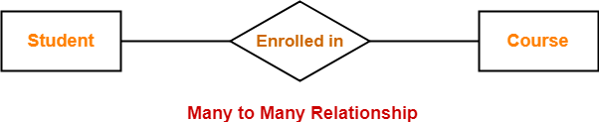
Here,
Any number of student can enroll in any number of courses.

Slide 49
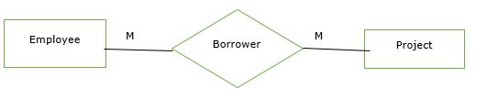
Example
1] Here, many employees work on many projects.
2] A many-to-many relationship exists between customers and products: customers can purchase various products, and products can be purchased by many customers.

Slide 50
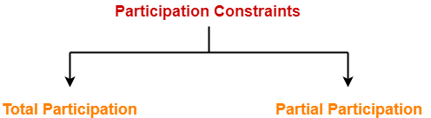
Participation
Types of Participation Constraints-
Participation constraints deal with the participation of entities from an entity set in a relationship set

Slide 51
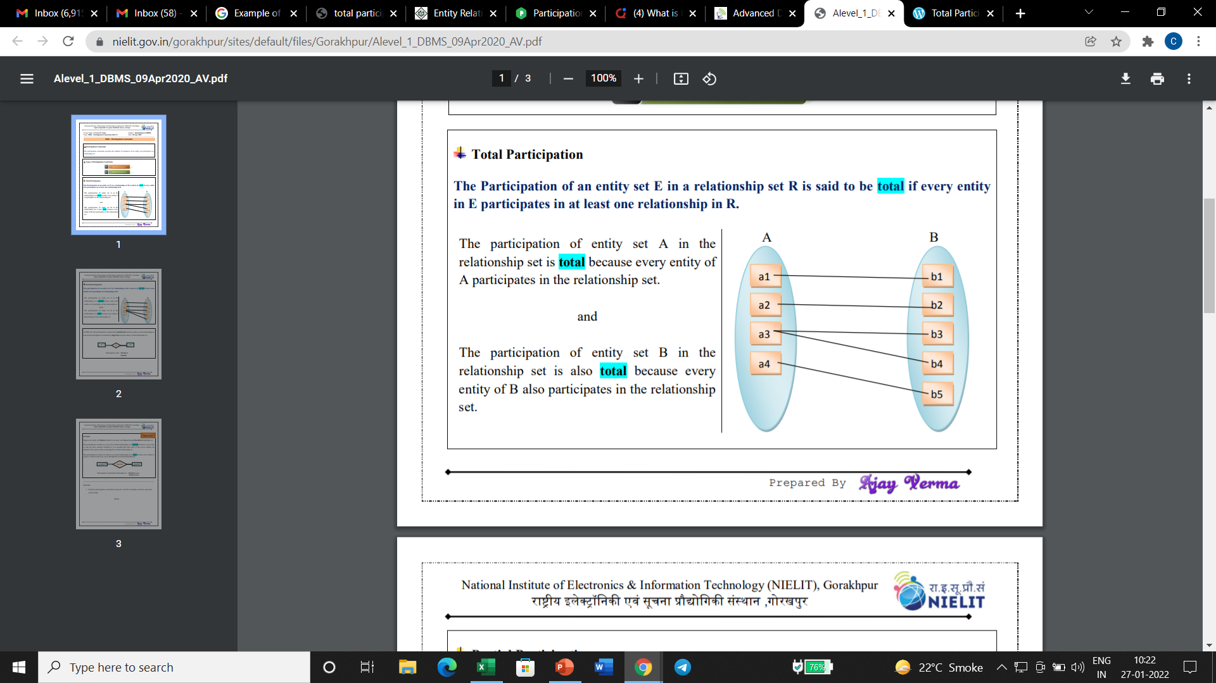
1. Total Participation-
The Participation of an entity set E in a relationship set R is said to be total if every entity in E participates in at least one relationship in R.

Slide 52
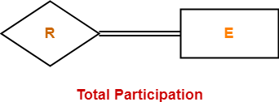

Slide 53
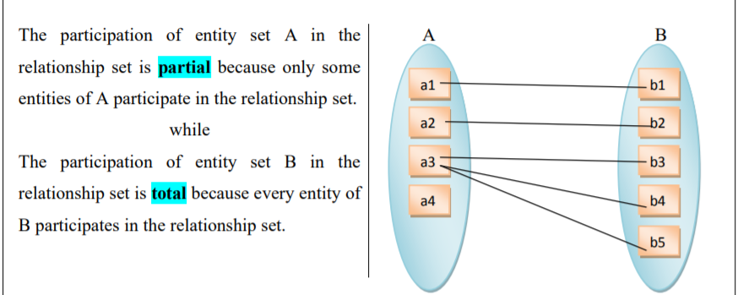
The material in this presentation belongs to St. Francis Institute of Technology and is solely for educational purposes. Distribution and modifications of the content is prohibited.
2. Partial Participation-
The participation of an entity set E in relationship set R is said to be partial if only some entities in E participate in relationships in R
St. Francis Institute of Technology
Department of Computer Engineering
Database Management System
53

Slide 54
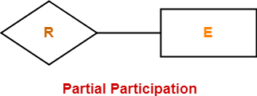
The material in this presentation belongs to St. Francis Institute of Technology and is solely for educational purposes. Distribution and modifications of the content is prohibited.
St. Francis Institute of Technology
Department of Computer Engineering
Database Management System
54

Slide 55
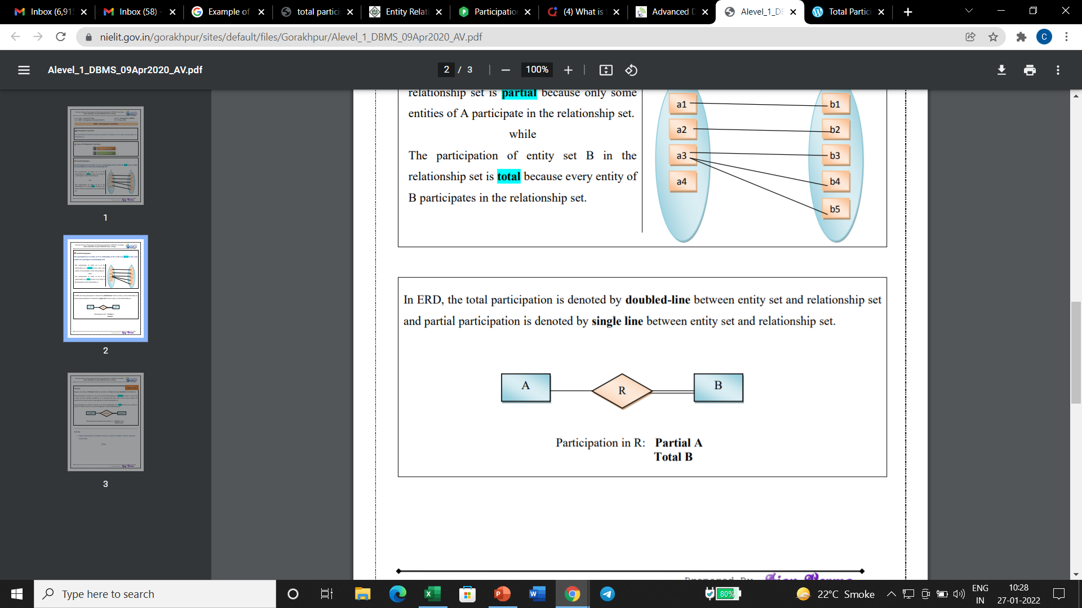
In ERD, the total participation is denoted by doubled-line between entity set and relationship set and partial participation is denoted by single line between entity set and relationship set.

Slide 56
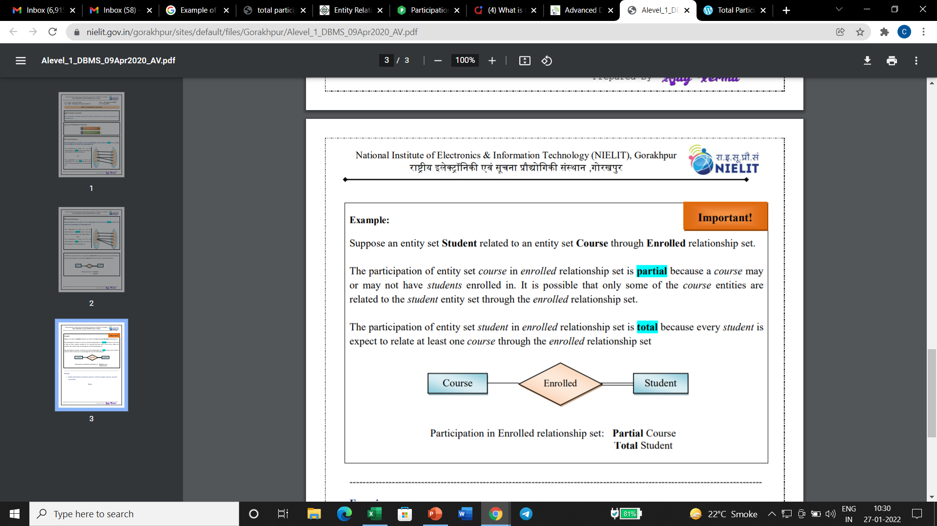
Example:
Suppose an entity set Student related to an entity set Course through Enrolled relationship set.
Single line between the entity set “Course” and relationship set “Enrolled in” signifies partial participation.It specifies that there might exist some courses for which no enrollments are made.
Double line between the entity set “Student” and relationship set “Enrolled in” signifies total participation.It specifies that each student must be enrolled in at least one course.

Slide 57
Degree of Relationship
The degree of a relationship is the number of entity types that participate(associate) in a relationship.
The number of an entity type that is connected to a relationship is the degree of that relationship .

Slide 58
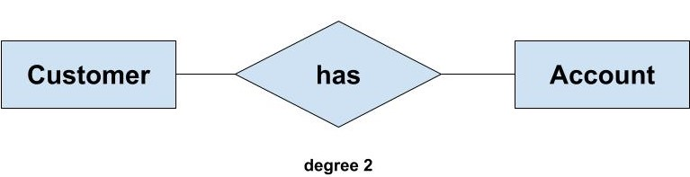
For example, If we have two entity type ‘Customer’ and ‘Account’ and they are linked using the primary key and foreign key.
We can say that the degree of relationship is 2 because here two entities are taking part in the relationship.

Slide 59
Based on the number of entity types that are connected we have the following degree of relationships:
Unary
Binary
Ternary
N-ary

Slide 60
1] Unary (degree 1)
A unary relationship exists when both the participating entity type are the same.
When such a relationship is present we say that the degree of relationship is 1.
Example: In the college presidential elections, a president is chosen among the students. He/she leads the entire community and looks after the student-centric activities. Even though he/she is the president, but after all is a student. So we can say that there is only one entity i.e., the student.

Slide 61
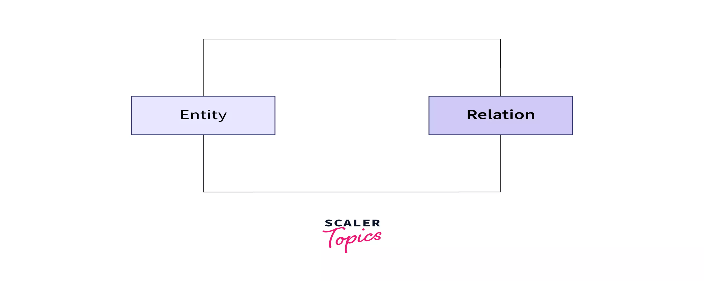
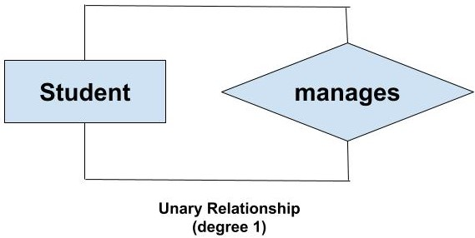

Slide 62
2] Binary (degree 2)
A binary relationship exists when exactly two entity type participates.
When such a relationship is present we say that the degree is 2.
This is the most common degree of relationship.

Slide 63
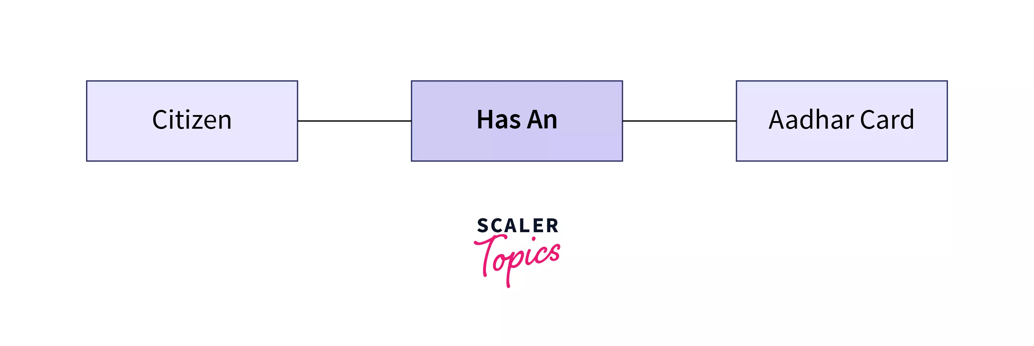
Example- Each Indian citizen has their own Aadhar Card so we can say that citizen and Aadhar Card are two entities involved.

Slide 64
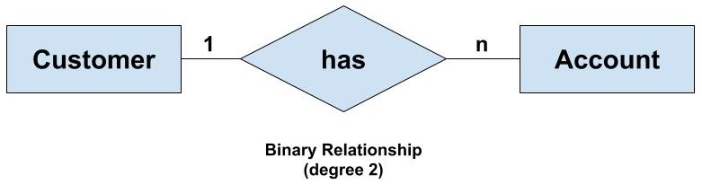
For example, We have two entity type ‘Customer’ and ‘Account’ where each ‘Customer’ has an ‘Account’ which stores the account details of the ‘Customer’. Since we have two entity types participating we call it a binary relationship. Also, one ‘Customer’ can have many ‘Account’ but each ‘Account’ should belong to only one ‘Customer’. We can say that it is a one-to-many binary relationship

Slide 65
3]Ternary(degree 3)
A ternary relationship exists when exactly three entity type participates.
When such a relationship is present we say that the degree is 3.

Slide 66
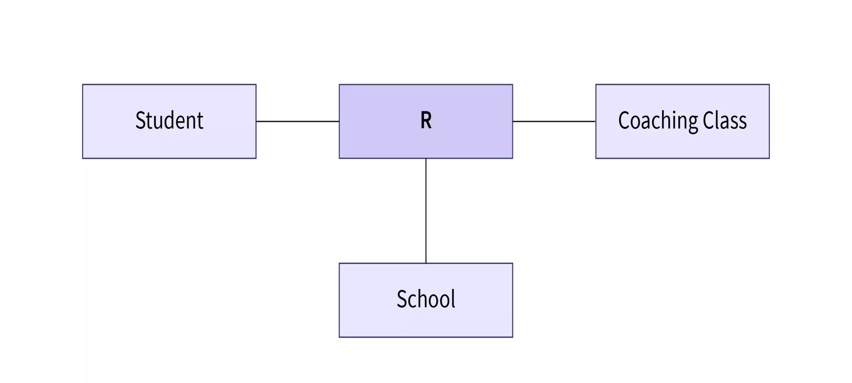
Example- A student studies in a school, so student and school are two entities. But, the same student also takes some coaching classes, so he has a relation with coaching as well, so coaching class is also an entity. Here as there are 3 entities, so it is a ternary relationship.

Slide 67

For example, We have three entity type ‘Employee’, ‘Department’ and ‘Location’. The relationship between these entities are defined as an employee works in a department, an employee works at a particular location. So, we can see we have three entities participating in a relationship so it is a ternary relationship. The degree of this relation is 3.

Slide 68

4] N-ary (n degree)
An N-ary relationship exists when ‘n’ number of entities are participating. So, any number of entities can participate in a relationship. There is no limitation to the maximum number of entities that can participate.

Slide 69

Example- Let us consider the example of a university. It has many entities like students, teachers, affiliated colleges, courses, etc. Here, there are many entities associated with the university.

Slide 70


Slide 71

The material in this presentation belongs to St. Francis Institute of Technology and is solely for educational purposes. Distribution and modifications of the content is prohibited.
St. Francis Institute of Technology
Department of Computer Engineering
Database Management System
71

Slide 72
Name of student | marks | course
s | 10 | CS
d | 50 | IT
d | 35 | IT
r | 50 | IT

Slide 73


Keys
It is used to uniquely identify any record or row of data from the table.
It is also used to establish and identify relationships between tables.
For example: In Student table, ID is used as a key because it is unique for each student. In PERSON table, passport_number, license_number are keys since they are unique for each person.

Slide 74

The material in this presentation belongs to St. Francis Institute of Technology and is solely for educational purposes. Distribution and modifications of the content is prohibited.
Types of key:
St. Francis Institute of Technology
Department of Computer Engineering
Database Management System
74

Slide 75
The material in this presentation belongs to St. Francis Institute of Technology and is solely for educational purposes. Distribution and modifications of the content is prohibited.
1. Super Key
Super key is a set of an attribute which can uniquely identify a tuple. Super key is a superset of a candidate key.
Super Key can contain multiple attributes that might not be able to independently identify tuples in a table, but when grouped with certain keys, they can identify tuples uniquely.
For example: In the EMPLOYEE table, for(EMPLOEE_ID, EMPLOYEE_NAME) the name of two employees can be the same, but their EMPLYEE_ID can't be the same. Hence, this combination can also be a key.
St. Francis Institute of Technology
Department of Computer Engineering
Database Management System
75

Slide 76


consider an EMPLOYEE_DETAIL table example where we have the following attribute:
Emp_SSN: The SSN number is stored in this field.
Emp_Id: An attribute that stores the value of the employee identification number.
Emp_name: An attribute that stores the name of the employee holding the specified employee id.
Emp_email: An attribute that stores the email id of the specified employees.

Slide 77
Consider the following Student schema-
Student ( roll , name , address)
examples of super keys for Student table-
( roll , name , address )
(roll , Name)
(roll , address)
(Roll)
NOTE-
All the attributes in a super key are definitely sufficient to identify each tuple uniquely in the given relation but all of them may not be necessary.
A candidate key is a super key but vice versa is not true

Slide 78

The material in this presentation belongs to St. Francis Institute of Technology and is solely for educational purposes. Distribution and modifications of the content is prohibited.
2. Candidate key
A candidate key is an attribute or set of an attribute which can uniquely identify a tuple.
The remaining attributes except for primary key are considered as a candidate key. The candidate keys are as strong as the primary key.
For example: In the EMPLOYEE table, id is best suited for the primary key. Rest of the attributes like SSN, Passport_Number, and License_Number, etc. are considered as a candidate key.
A table can have multiple candidate keys but only a single primary key.
St. Francis Institute of Technology
Department of Computer Engineering
Database Management System
78

Slide 79
The candidate key can be simple (having only one attribute) or composite as well.
For Example, {STUD_NO, COURSE_NO} is a composite candidate key for relation STUDENT_COURSE.
Properties of Candidate key:
A candiate key can never be NULL or empty. And its value should be unique.
There can be more than one candidate keys for a table.
A candidate key can be a combination of more than one columns(attributes).

Slide 80
SID | SNAME | MAILID
1 | hyyu | ui
2 | uiui | iiiu
3 | juyiyi | nhhyj

Slide 81

The material in this presentation belongs to St. Francis Institute of Technology and is solely for educational purposes. Distribution and modifications of the content is prohibited.
St. Francis Institute of Technology
Department of Computer Engineering
Database Management System
81

Slide 82

The material in this presentation belongs to St. Francis Institute of Technology and is solely for educational purposes. Distribution and modifications of the content is prohibited.
3. Primary key
It is the first key which is used to identify one and only one instance of an entity uniquely.
A table cannot have more than one primary key.
In the EMPLOYEE table, ID can be primary key since it is unique for each employee. In the EMPLOYEE table, we can even select License_Number and Passport_Number as primary key since they are also unique.
St. Francis Institute of Technology
Department of Computer Engineering
Database Management System
82

Slide 83
Rules for defining Primary key:
Two rows can’t have the same primary key value
The primary key field cannot be null.

Slide 84

For the table Student we can make the student_id column as the primary key

Slide 85
The material in this presentation belongs to St. Francis Institute of Technology and is solely for educational purposes. Distribution and modifications of the content is prohibited.
4. Foreign key
Foreign keys are the column of the table which is used to point to the primary key of another table.
A foreign key is the one that is used to link two tables together via the primary key. It means the columns of one table points to the primary key attribute of the other table.
St. Francis Institute of Technology
Department of Computer Engineering
Database Management System
85

Slide 86
EID | ENAme | aDD
1 | A | gtyt
2 | V | hgtyht
3 | D | yuyu
DEpt | DNAME | Extension number
101 | mca
102 | cs

Slide 87


Slide 88


Consider two tables Student and Department having their respective attributes as shown in the below table structure:
In the Student table, the field Stud_Id is a primary key because it is uniquely identifying all other fields of the Student table.
On the other hand, Stud_Id is a foreign key attribute for the Department table because it is acting as a primary key attribute for the Student table. It means that both the Student and Department table are linked with one another because of the Stud_Id attribute.

Slide 89

structure of the relationship between the two tables.

Slide 90
The material in this presentation belongs to St. Francis Institute of Technology and is solely for educational purposes. Distribution and modifications of the content is prohibited.
Extended Entity-Relationship (EE-R) Model
EER is a high-level data model that incorporates the extensions to the original ER model.
In addition to ER model concepts EE-R includes −
Subclasses and Super classes.
Specialization and Generalization.
Aggregation.
These concepts are used to create EE-R diagrams.
St. Francis Institute of Technology
Department of Computer Engineering
Database Management System
90

Slide 91

Subclasses and Super class
Super class is an entity that can be divided into further subtype.
A superclass is the class from which many subclasses can be created.
The subclasses inherit the characteristics of a superclass.
The superclass is also known as the parent class or base class.
For example − consider Shape super class.

Slide 92

Super class shape has sub groups: Triangle, Square and Circle.
Sub classes are the group of entities with some unique attributes.
Sub class inherits the properties and attributes from super class.

Slide 93


Slide 94

Example –
consider we have 3 sets of employees: Secretary, Technician, and Engineer.
The employee is super-class of the rest three sets of individual sub-class is a subset of Employee set.

Slide 95
The material in this presentation belongs to St. Francis Institute of Technology and is solely for educational purposes. Distribution and modifications of the content is prohibited.
Specialization
The process of defining subclasses of an entity type is called specialization.
• This entity type is called “superclass” of the specialization.
• Specialization distinguishes between subclasses based on a certain method:-
Example: Salaried Employee and Hourly Employee are grouped together because they are classified based on paying method.
St. Francis Institute of Technology
Department of Computer Engineering
Database Management System
95

Slide 96
The material in this presentation belongs to St. Francis Institute of Technology and is solely for educational purposes. Distribution and modifications of the content is prohibited.
The Employee entity type has 3 specializations:
{SalariedEmployee,HourlyEmployee}
- Classified based on paying method.
2) {Secretary, Technician, Engineer}
- Classified based on job type.
St. Francis Institute of Technology
Department of Computer Engineering
Database Management System
96

Slide 97

The material in this presentation belongs to St. Francis Institute of Technology and is solely for educational purposes. Distribution and modifications of the content is prohibited.
How specialization is represented in EER: –
Subclasses that define a specialization are attached by lines to a circle that represents the specialization, which is connected to the superclass.
• The subset symbol “U” on each line connecting a subclass to the circle indicates the direction of the superclass/subclass relationship.
• If the specialization contains only one subclass, we do not use the symbol which is used for grouping subclasses.
St. Francis Institute of Technology
Department of Computer Engineering
Database Management System
97

Slide 98


Slide 99

d means "disjoint"- what it tells is the subclasses must have disjoint sets of entities.
A disjoint relationship means that an entity from the superclass can belong to only one of the subclasses
Example :
An employee cannot be a physician assistant as well as a nurse, or, cannot be a nurse as well as a technician

Slide 100

U symbol indicates the Subtype is a subset of the Supertype.

Slide 101
The material in this presentation belongs to St. Francis Institute of Technology and is solely for educational purposes. Distribution and modifications of the content is prohibited.
In summary, specialization allows us to: –
Define subclasses of entity types.
Define specific attributes for subclasses.
Define specific relationships between subclasses and other entities or subclasses.
St. Francis Institute of Technology
Department of Computer Engineering
Database Management System
101

Slide 102

Generalization is a Bottom up process i.e. consider we have 3 sub entities Car, Truck and Motorcycle. Now these three entities can be generalized into one super class named as Vehicle
Specialization is a top down approach in which one entity is broken down into low level entity.

Slide 103
The material in this presentation belongs to St. Francis Institute of Technology and is solely for educational purposes. Distribution and modifications of the content is prohibited.
Generalization
• Generalization is the reverse process of specialization.
• In generalization, you generalize a set of entity types into one superclass entity type. Therefore, the generalized entity types are considered subclasses.
• If you find a set of classes with many common attributes, they can be considered subclasses and generalized to a common entity (superclass).
St. Francis Institute of Technology
Department of Computer Engineering
Database Management System
103

Slide 104
The material in this presentation belongs to St. Francis Institute of Technology and is solely for educational purposes. Distribution and modifications of the content is prohibited.
Example: In an ER diagram consider you have two entity types:
– Car
– Truck
How can we generalize this?
St. Francis Institute of Technology
Department of Computer Engineering
Database Management System
104

Slide 105

The material in this presentation belongs to St. Francis Institute of Technology and is solely for educational purposes. Distribution and modifications of the content is prohibited.
St. Francis Institute of Technology
Department of Computer Engineering
Database Management System
105

Slide 106

The material in this presentation belongs to St. Francis Institute of Technology and is solely for educational purposes. Distribution and modifications of the content is prohibited.
The common attributes go to the superclass and the current entity types (Car and Truck) become subclasses.
An Vehicle must either be car or truck-total participation
St. Francis Institute of Technology
Department of Computer Engineering
Database Management System
106

Slide 107
The material in this presentation belongs to St. Francis Institute of Technology and is solely for educational purposes. Distribution and modifications of the content is prohibited.
Generalization is the process of extracting common properties from a set of entities and create a generalized entity from it.
It is a bottom-up approach in which two or more entities can be generalized to a higher level entity if they have some attributes in common.
For Example, STUDENT and FACULTY can be generalized to a higher level entity called PERSON. In this case, common attributes like P_NAME, P_ADD become part of higher entity (PERSON) and specialized attributes like S_FEE become part of specialized entity (STUDENT).
St. Francis Institute of Technology
Department of Computer Engineering
Database Management System
107

Slide 108
The material in this presentation belongs to St. Francis Institute of Technology and is solely for educational purposes. Distribution and modifications of the content is prohibited.
Specialization – In specialization, an entity is divided into sub-entities based on their characteristics. It is a top-down approach where higher level entity is specialized into two or more lower level entities. For Example, EMPLOYEE entity in an Employee management system can be specialized into DEVELOPER, TESTER etc.
In this case, common attributes like E_NAME, E_SAL etc. become part of higher entity (EMPLOYEE) and specialized attributes like TES_TYPE become part of specialized entity (TESTER).
St. Francis Institute of Technology
Department of Information Technology
Database Management System
108

Slide 109

The material in this presentation belongs to St. Francis Institute of Technology and is solely for educational purposes. Distribution and modifications of the content is prohibited.
St. Francis Institute of Technology
Department of Information Technology
Database Management System
Prachiti Pimple
109

Slide 110
The material in this presentation belongs to St. Francis Institute of Technology and is solely for educational purposes. Distribution and modifications of the content is prohibited.
Aggregation
An ER diagram is not capable of representing relationship between an entity and a relationship which may be required in some scenarios.
In those cases, a relationship with its corresponding entities is aggregated into a higher level entity.
Aggregation is an abstraction through which we can represent relationships as higher level entity sets.
St. Francis Institute of Technology
Department of Information Technology
Database Management System
110

Slide 111
For Example, Employee working for a project may require some machinery. So, REQUIRE relationship is needed between relationship WORKS_FOR and entity MACHINERY. Using aggregation, WORKS_FOR relationship with its entities EMPLOYEE and PROJECT is aggregated into single entity and relationship REQUIRE is created between aggregated entity and MACHINERY.

Slide 112

The material in this presentation belongs to St. Francis Institute of Technology and is solely for educational purposes. Distribution and modifications of the content is prohibited.
St. Francis Institute of Technology
Department of Information Technology
Database Management System
112

Slide 113

For example: Center entity offers the Course entity act as a single entity in the relationship which is in a relationship with another entity visitor. In the real world, if a visitor visits a coaching center then he will never enquiry about the Course only or just about the Center instead he will ask the enquiry about both.

Slide 114

The material in this presentation belongs to St. Francis Institute of Technology and is solely for educational purposes. Distribution and modifications of the content is prohibited.
In real world, we know that a manager not only manages the employee working under them but he has to manage the project as well. In such scenario if entity “Manager” makes a “manages” relationship with either “Employee” or “Project” entity alone then it will not make any sense because he has to manage both. In these cases the relationship of two entities acts as one entity. In our example, the relationship “Works-On” between “Employee” & “Project” acts as one entity that has a relationship “Manages” with the entity “Manager”.
St. Francis Institute of Technology
Department of Information Technology
Database Management System
114

Slide 115
The material in this presentation belongs to St. Francis Institute of Technology and is solely for educational purposes. Distribution and modifications of the content is prohibited.
Module 2 Done!!
St. Francis Institute of Technology
Department of Information Technology
Database Management System
115

